Slide 1



Team: De Mooi
Personalized Video Statement
Subrahmanyam (Subhu)
Firoz
Praveen
Notes:
Group Presentation
September 2003
Company Confidential
© 2004 Capgemini - All rights reserved

Slide 2
ABN AMRO
Balance
Overall
Relevant
Info
Credits
Statement
Loans
Debits
Analytics
GRIP
Tikkie
November 2004 - Group Presentation
Notes:
Group Presentation
September 2003
Company Confidential
© 2004 Capgemini - All rights reserved
When relevant, you can add this text at the end of the slide:
Capgemini employs approximately 60,000 people worldwide and reported 2003 global revenues
of 5.7 billion euros.

Slide 3





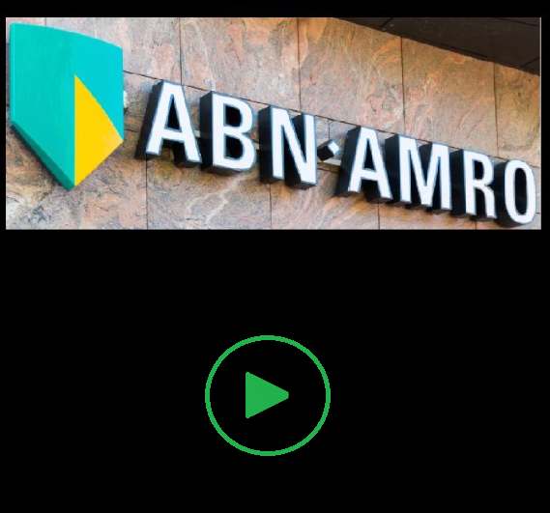


ABN AMRO
User Personalized Relevant INFORMATION
November 2004 - Group Presentation
Notes:
Group Presentation
September 2003
Company Confidential
© 2004 Capgemini - All rights reserved
When relevant, you can add this text at the end of the slide:
Capgemini employs approximately 60,000 people worldwide and reported 2003 global revenues
of 5.7 billion euros.

Slide 4








ABN AMRO
Technologies
November 2004 - Group Presentation
Notes:
Group Presentation
September 2003
Company Confidential
© 2004 Capgemini - All rights reserved
When relevant, you can add this text at the end of the slide:
Capgemini employs approximately 60,000 people worldwide and reported 2003 global revenues
of 5.7 billion euros.

Slide 5

ABN AMRO
November 2004 - Group Presentation
Notes:
Group Presentation
September 2003
Company Confidential
© 2004 Capgemini - All rights reserved
When relevant, you can add this text at the end of the slide:
Capgemini employs approximately 60,000 people worldwide and reported 2003 global revenues
of 5.7 billion euros.

Slide 6
ABN AMRO
Thank You
Q & A
November 2004 - Group Presentation
Notes:
Group Presentation
September 2003
Company Confidential
© 2004 Capgemini - All rights reserved
When relevant, you can add this text at the end of the slide:
Capgemini employs approximately 60,000 people worldwide and reported 2003 global revenues
of 5.7 billion euros.

